Slide 1
MyCollegeCompass
College Predictor
Date of presentation: 11th May 2023
Guided by:
Dr. R. RAJA
Associate Professor
ET-CSIT
By:
Nallamothu Akash - 20B81A3306
Bhavik Goyal - 20B81A3313
Ganta Rajashekar - 20B81A3331

Slide 2
Abstract
The college prediction mobile app is a revolutionary tool that utilizes advanced Machine Learning algorithms and data analysis to predict the likelihood of acceptance into various colleges and universities.
The app takes into account a wide range of factors, including Rank, Gender, Category(caste), and Domicile State to provide users with a highly accurate prediction of their chances of being admitted to their desired institutions.

Slide 3
Introduction
The College Prediction Mobile App provides students with a unique advantage by providing them with insights into their chances of getting admitted to their desired institutions.
By using this app, students can save time and effort by focusing on the colleges and universities where they have the highest likelihood of being accepted.

Slide 4
References
Careers360: It is a platform where students can check their preferred colleges according to their JEE/Eamcet rank and also they can see the current top colleges list.
Shiksha: In this website students can refer to the colleges according to the exams that they have given like JEE Mains or Eamcet.

Slide 5
Functional Requirements
User input details: The user should be able to input their JEE/TS Eamcet rank and their details.
Predictive Analytics: The app should use an ML model to predict the likelihood of a user getting accepted into a particular college based on various inputs.
Responsive design: The model should be designed to work on different screen sizes and devices.

Slide 6
Non-functional Requirements
Performance: The app should respond quickly and provide accurate predictions in a reasonable amount of time.
Usability: The app should be easy to use and navigate, with a clean and intuitive user interface. It should also be accessible to users with disabilities.
Maintainability: The app should be easy to maintain and update, with well-structured code and clear documentation.
Performance under load: The app should be able to handle a large number of users simultaneously without crashing or slowing down.
Scalability: The app should be able to scale up or down to accommodate a growing or shrinking user base.

Slide 7
Software Requirements
There are a variety of tools and technologies that can be used to build a college prediction mobile application.
Flutter – Open Source UI SDK created by Google, provides Android framework.
Dart – UI is built in dart programming language.
Machine Learning – Different types of decision tree classifiers and models help build our predictor system using java.
Android studio – Development environment by Google’s Android OS

Slide 8
Hardware Requirements
Processor: Dual core or higher.
RAM: 4 GB or higher.
Storage: 64 GB or higher.
Operating System: Android or IOS
Display: 480 x 800 pixels or higher.

Slide 9
Modular Structure
User Interface (UI) Module: Responsible for handling user interactions and presenting information to the user. Includes screens, forms, buttons, and other UI components.
Data Collection Module: Collects user data which is required for prediction and validates before sending it to the prediction module.
Prediction Module: Performs the college prediction based on user-provided data. Utilizes machine learning algorithms to generate predictions. Receives data from the Data Collection module and returns the predicted college(s) to the UI module.
College Information Module: Retrieves and manages information about colleges. Retrieves college rankings, admission requirements, tuition fees, location, and other details.

Slide 10
Plan of action
Architecture
User
Input
Rank
Gender
Category
Domicile State
ML model
Result

Slide 11
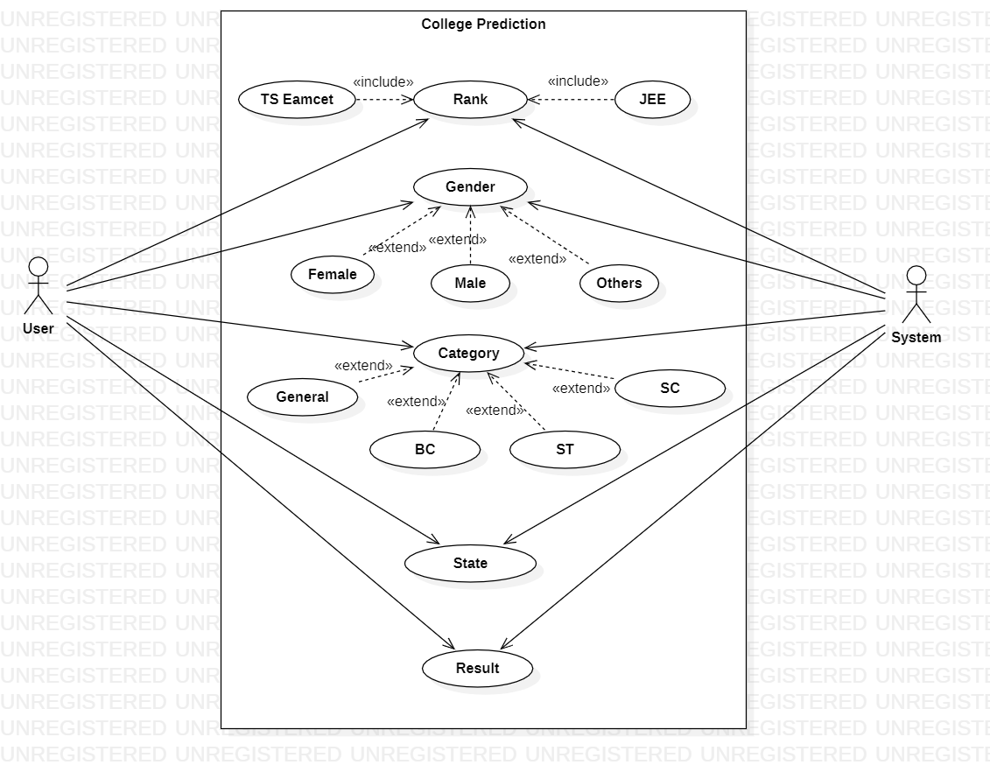
USECASE Diagram

Slide 12
THANK YOU!

